Slide 1
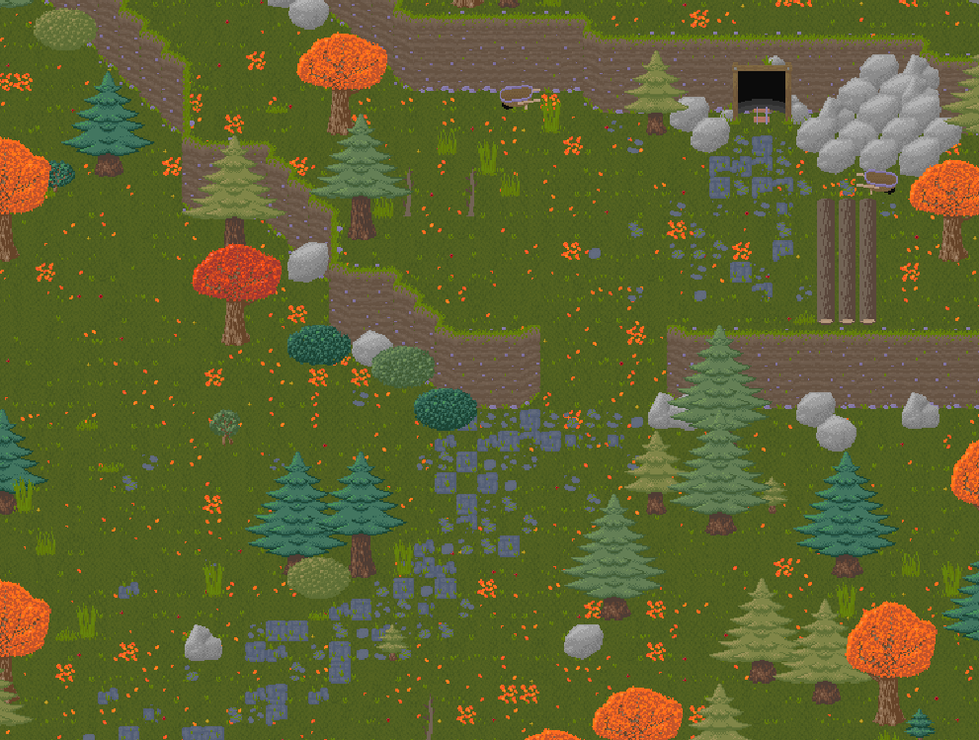


By:
Joseph Coats,
Owen Manley,
Kyle Walbring
Notes:
Our project is called “Darkstew Hollow,” a single player video game.

Slide 2

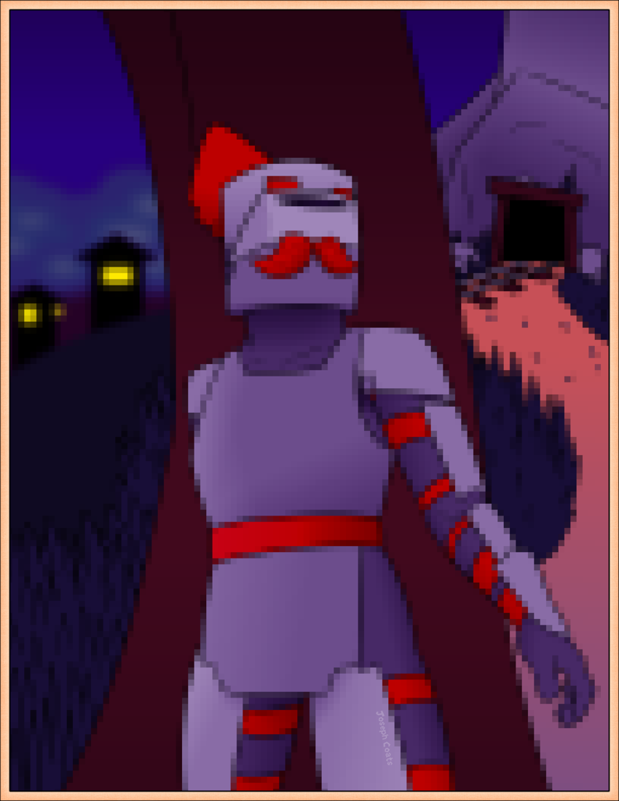

What is Darkstew Hollow?
Action-adventure game with roguelike elements.
Must fight back creatures and save residents to save the town.
Differs from roguelikes in that it lacks procedural generation.

Slide 3
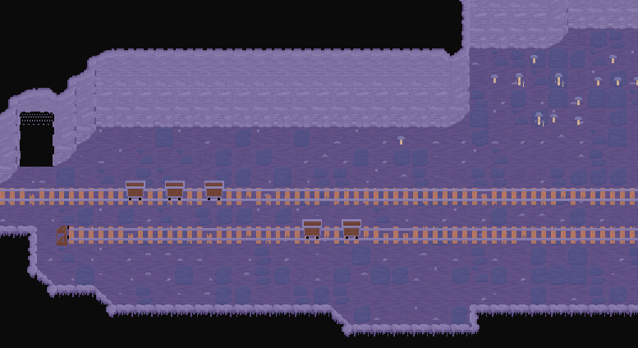
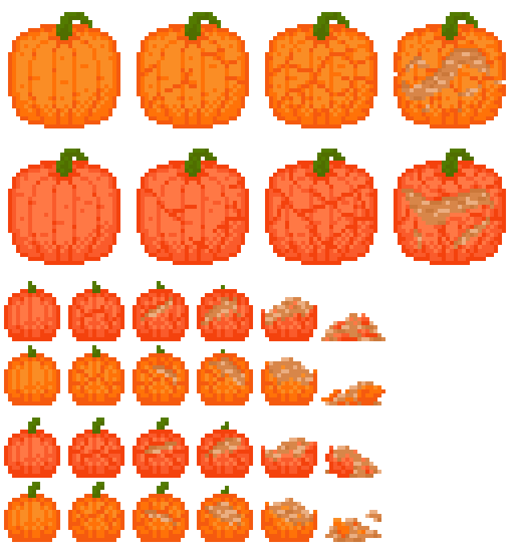
Motivation
Motivations are still the same compared to last semester.
Inspired by other popular games.
Wanted to give the genre a unique twist with geological elements.
Make it simple for people not used to video games.

Slide 4
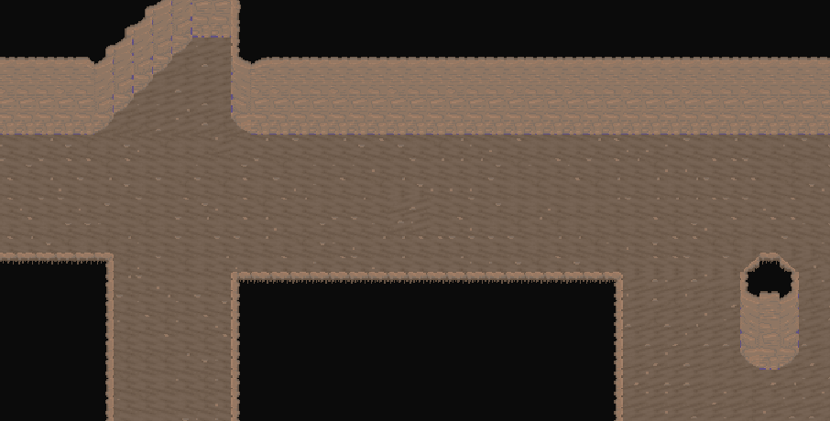
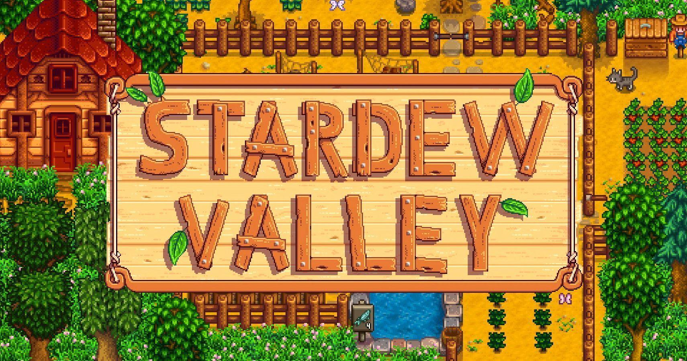
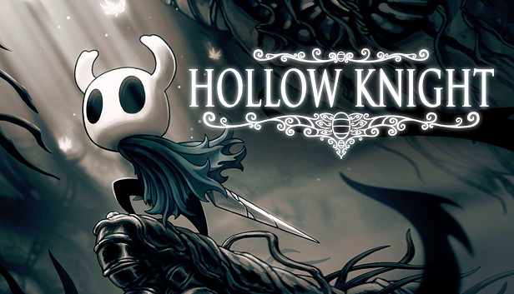
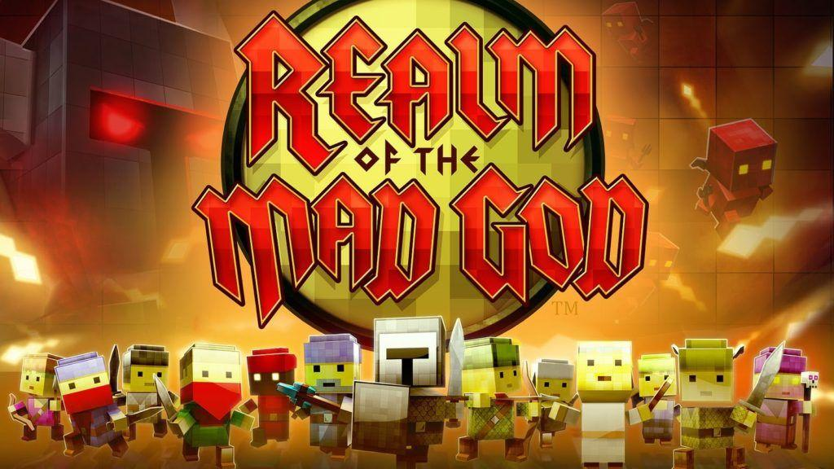
Inspired Works
Other video games such as:
Stardew Valley
Hollow Knight
Realm of The Mad God
Notes:
https://docs.google.com/document/d/1BEYX9qkGIGUJ_hjUe5gBMowLIADE74f_Qsw0e2b7gCc/edit?tab=t.0

Slide 5

Functional Requirements Implemented
The game should be able to offer single-player.
The player should be able to interact with the character using a keyboard/mouse or a controller.
The game should allow certain UI elements such as a health bar, a hotbar, a main menu, an inventory, options for sound and graphics, as well as dialogue boxes.
Player should be able mine nodes and find artifacts in levels to receive the ability to rebuild back in Ironhaven.
Game should allow progress to be saved.
Notes:
https://docs.godotengine.org/en/stable/about/system_requirements.html

Slide 6

Functional Requirements In Progress
The player should have the ability to upgrade equipment back in Ironhaven once requirements are met.
The player should have a variety of different solutions to counter enemies (melee, magic, ranged).
Notes:
Players should have a variety of different solutions to counter enemies (melee, magic, ranged, etc).
Game should allow a log so players know how many materials is needed to construct a building when delving in the mines (toggleable).
NPCs should exhibit realistic behavior when encountered; enemy AI the same when encountered.

Slide 7
Non-Functional Requirements Implemented
UI should be simple and intuitive to navigate.

Slide 8
Non-Functional Requirements in progress
The game should be able to perform on low-end pcs.
Should be compatible with Windows.
Game should be able to run on a higher frame rate average (60).
Game should have achievements in-game.
Game should have a system where they can only hold a certain amount of a material in their inventories to prevent exceeding progress in their present state.
The game should be able to run on low-end PCs like laptops with 8GB of RAM.

Slide 9
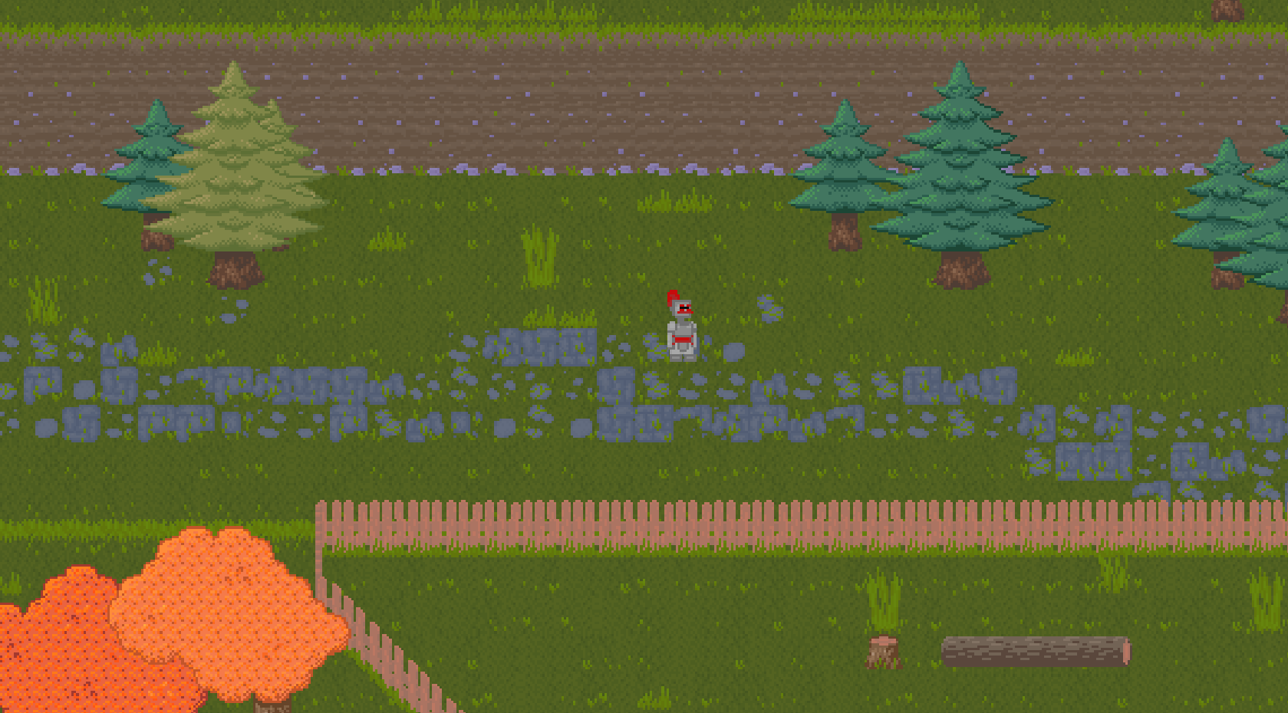
Technical Content
Tutorial
UI elements
Object spawning
NPC pathfinding
Notes:
During the development of Darkstew Hollow, there have been many implementations as well as improvements on existing features.
The first challenge in terms of game-design and intuitive UI is the tutorial level, which has gone through several iterations with the aim to introduce the plot and the player controls.
Then, the UI has also been developed, providing a consistent theme that is responsive to user input. With the most recent achievement being the inventory system, we were able to manage and visualize data effectively to the user.
Another important challenge was the systematized spawning of objects, such as naturally occuring mineral nodes and enemies. Godot’s engine has made this difficult to accomplish at first, but we were able to appropriately resolve the issue after extensive testing.
A very recent challenge is of the new pathfinding system. Previously, our prototype enemies moved on a predetermined path, but recent discoveries in Godot have shown that built-in pathfinding is available,
so both enemies and other characters are capable of wandering and following the player perfectly.
Meanwhile, we have also made great progress in improving both the enemies and the player’s control.
While we have spent less time on the enemies themselves, we were able to improve their AI by giving them the ability to see the player and chase them.
As for the player, we have given them more controls that will be featured in the final game, such as mining and sprinting.
We have also added varying support for the use of console controllers.
Lastly, we have implemented player health, which is represented by a GUI element in the bottom left of the screen.

Slide 10
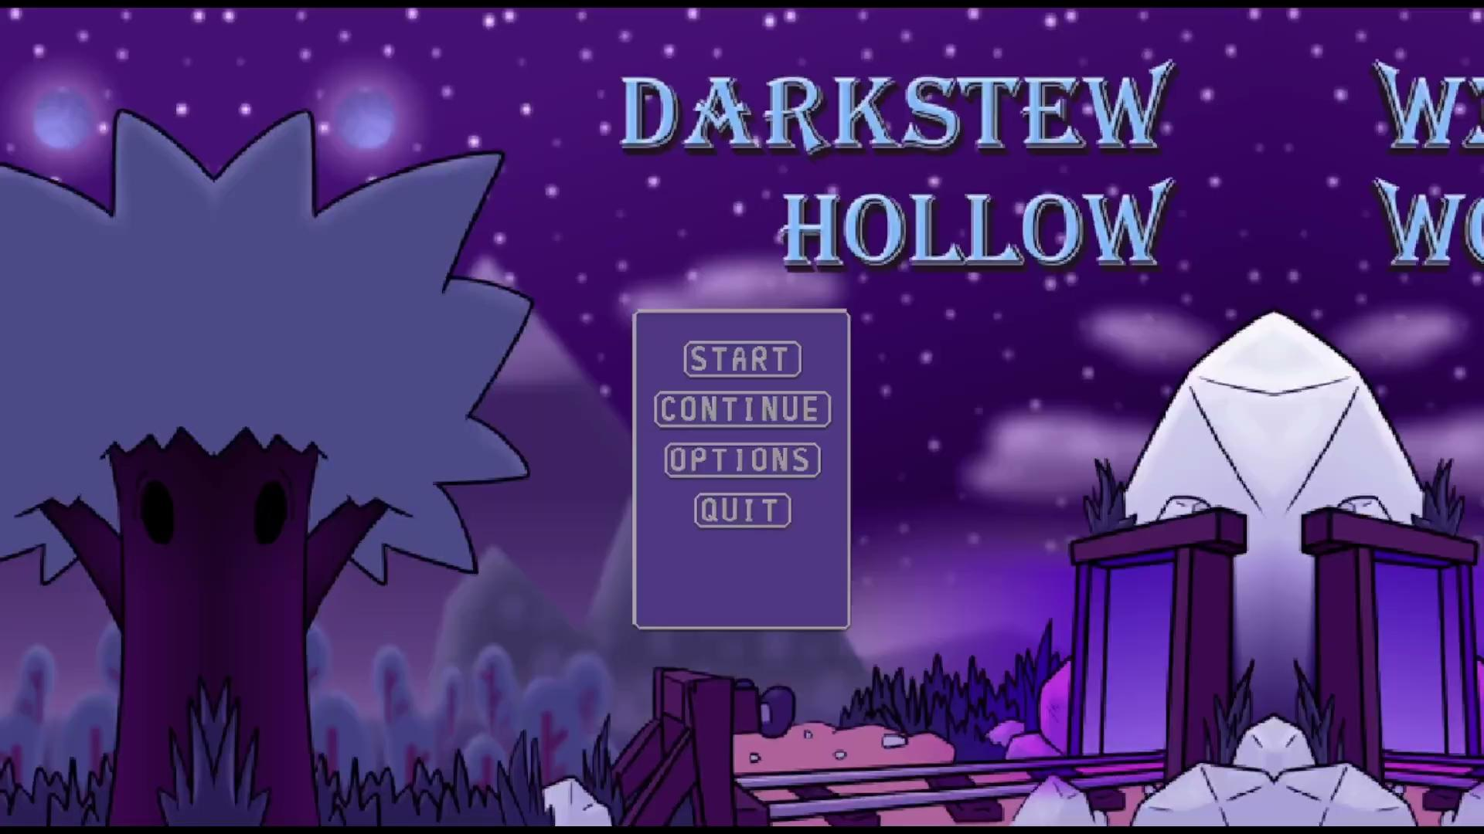
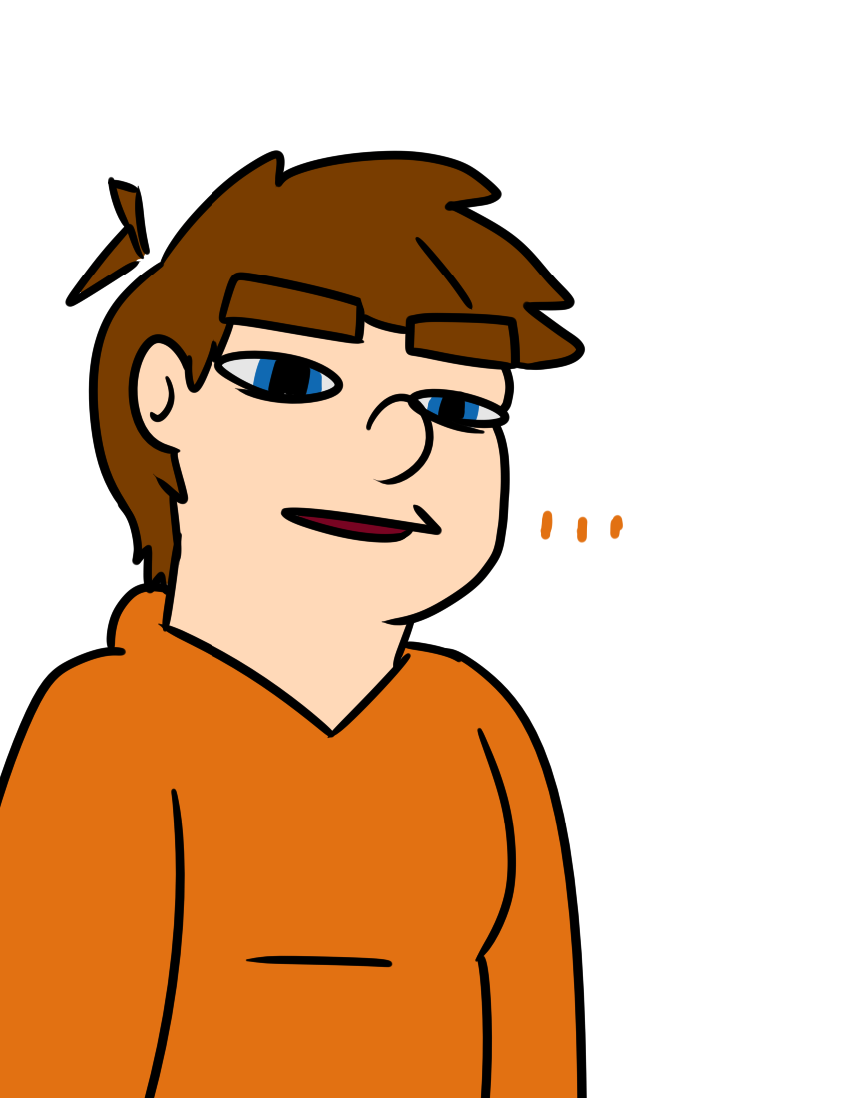
Previous Demo

Slide 11
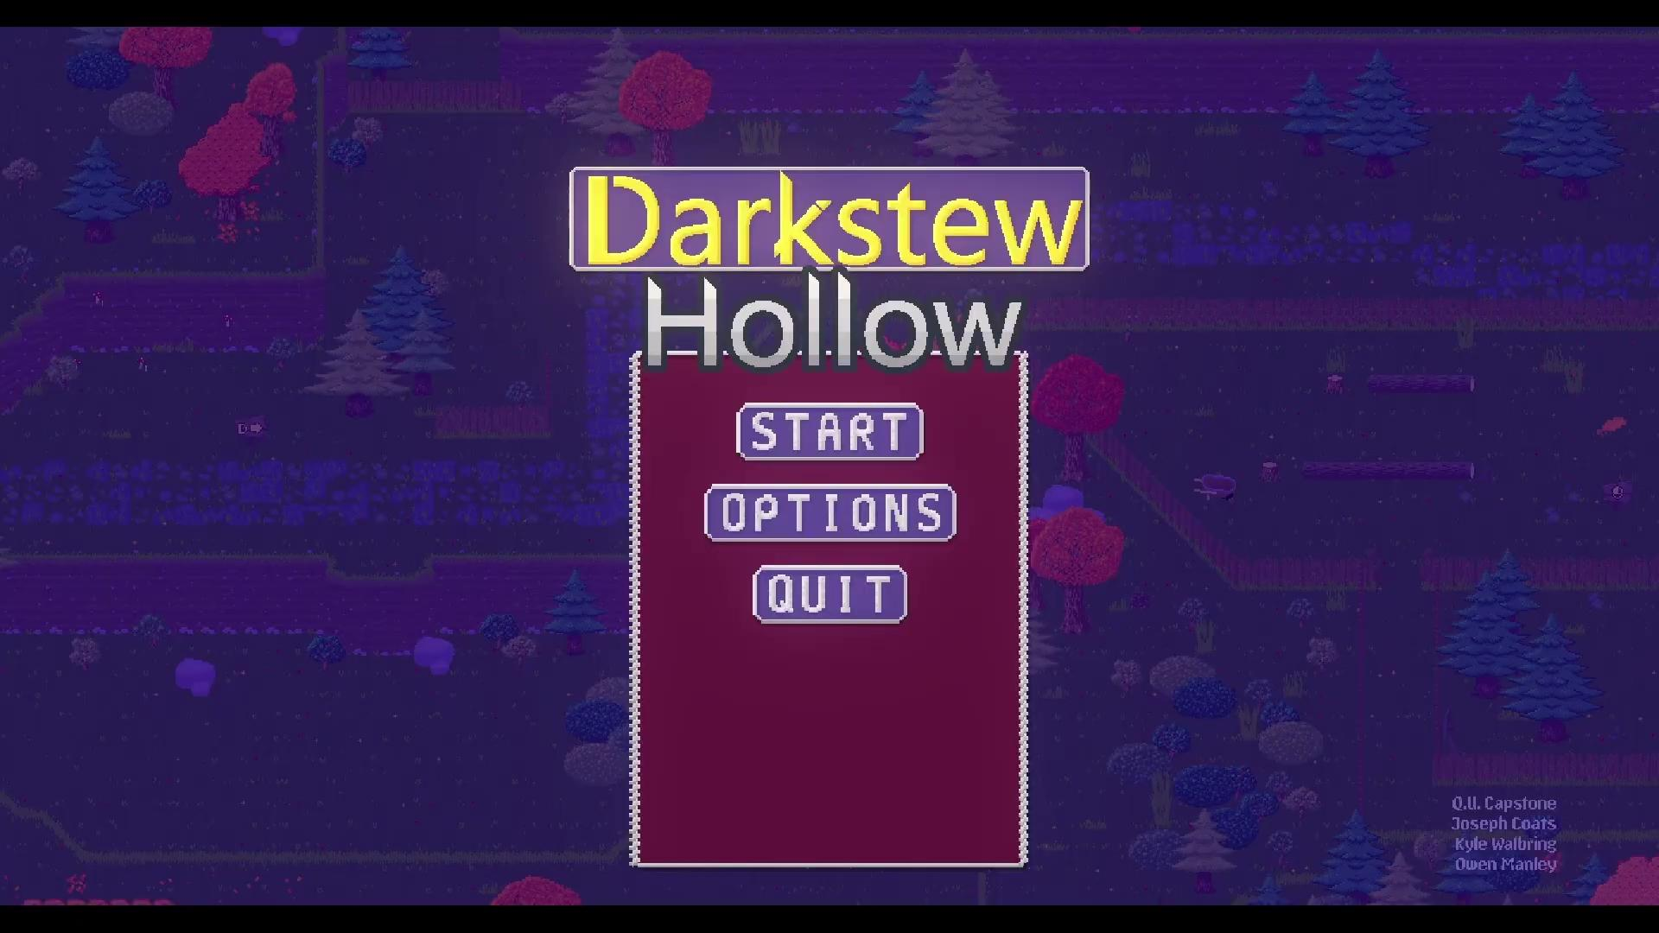

Current Demo

Slide 12
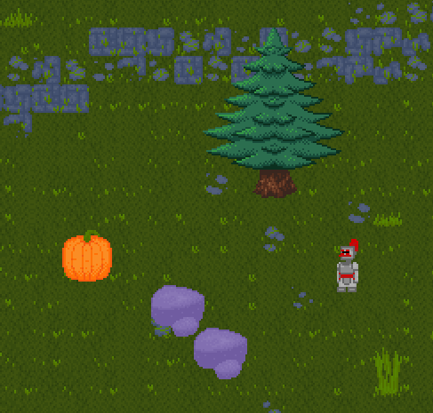
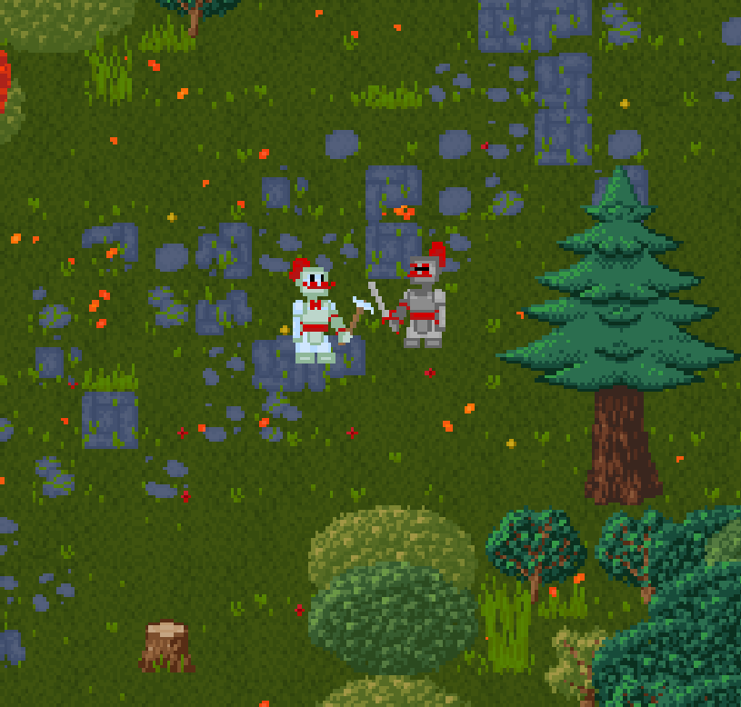


Summary
Notes:
In conclusion, Darkstew Hollow is a single player video game with standard requirements that are able to be met on considerably low-end computers.
We have become familiar with Godot and have successfully added almost all core features we have planned, with an increasing velocity from last semester.
Many of its core ideas are derived from games that are similar to it, with a lighter, humorous twist.
The controls the returning hero, Johnny, who has arrived to his hometown only to learn about an unfortunate incident in the mines.
He must now fight a large variety of enemies to save his friends (and restore their town) from the disturbed forces the hide below.

